Slide 1
Hotel Review Parsing: Pre and Post Pandemic
Data Science Masters Capstone
DATS 6501
Mariko McDougall

Slide 2
Index

Slide 3
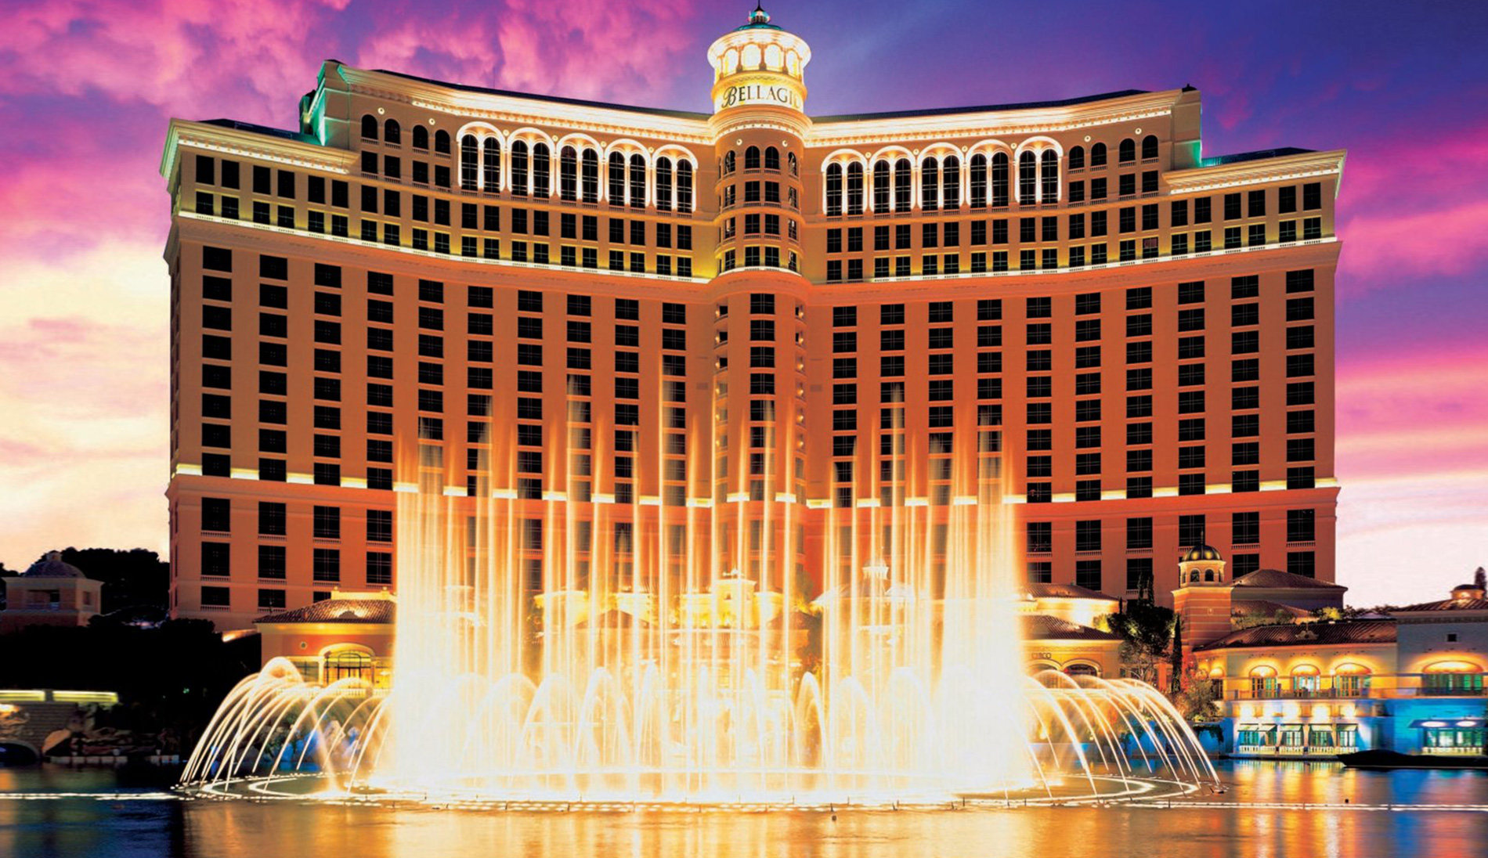
Introduction
The hotel industry, worth over 240 billion dollars globally*, was highly impacted by the Covid-19 pandemic.
Due to both health concerns and travel restrictions, occupancy declined more than 11%, and 4.4% of hotels permanently closed in 2020**.
*Strategic Report - Industry Overview 2020. IHG Hotels and Resorts - Annual reports. (2020).
**Q3 2021 US Hotel Figures. CBREUS Insights and Research. (2021).

Slide 4
Problem Statement
Given the hotel industry’s intense competition for limited customers, knowing what factors have the highest impact on a visitor’s experience is critical to maintaining high review scores, satisfaction and occupancy.
Discerning critical factors may be particularly important now, as customer expectations and requirements may have shifted during the pandemic. For example, sanitation practices are now on the forefront of customers’ minds, where previously they may have had less of an impact on reviews.
Factors will be compared from reviews written both before and during the pandemic, to discern if priorities have changed.

Slide 5
Literature Review

Slide 6
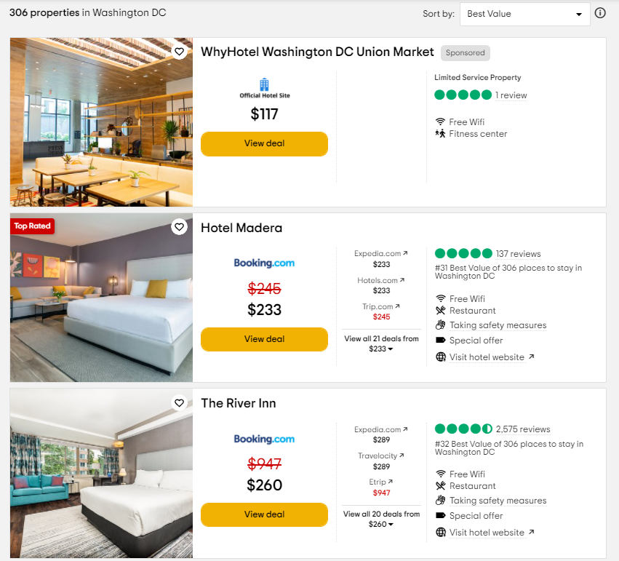
Dataset - Cities
For each city, capture the number of properties, and loop through all pages of listings.
Hotel Listing
Collect link to hotel page if there are more than 50 reviews for the property
This saves time, especially as many small properties do not have any reviews.
Page Sorting
The default sorting system weights for number of reviews, as well as star rating and cost
Once more than half of the page has less than 50 reviews, stop scraping for hotel links.

Slide 7
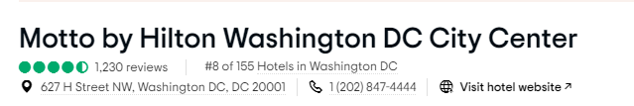
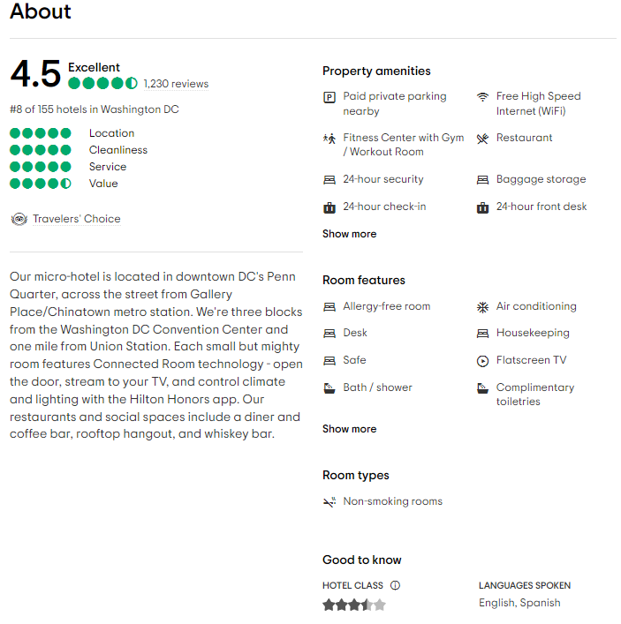
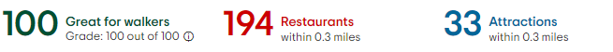
Dataset - Hotel
Hotel ID
Unique ID code combining the city and hotel ID
Hotel Basic Information Section
Hotel name
Number of reviews
Hotel address
About Section
Hotel blurb
Property amenities and Room features
Hotel star rating
Location Section
Walkability score
Restaurants within distance
Attractions within distance

Slide 8
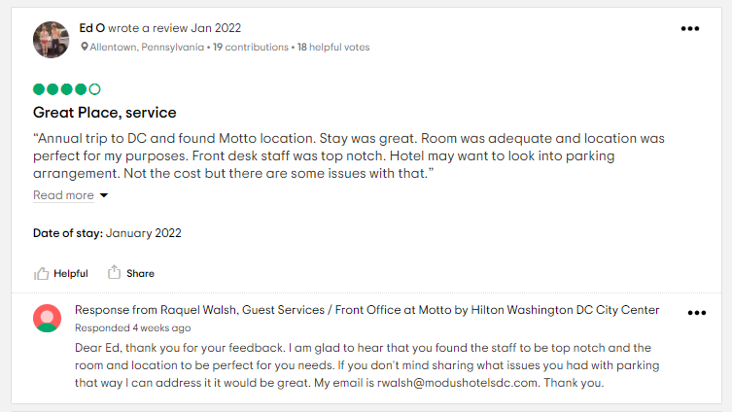
Dataset - Review
Hotel ID
Review Information
Star rating
Title
Text of the actual review
Date of the stay
Reviewer Information
Date review written
Reviewer home location
Maximum of 4000 reviews per hotel
Necessary, as many large hotels have 30,000+ reviews, and reviews are displayed in increments of 5.
For most highly reviewed hotels, this puts us into reviews from 2017.

Slide 9
Data Preprocessing
Hotel Database
Reviews Database
Parse state from the hotel address
Some hotels served major cities, but were not technically within the city boundaries (eg, Paradise,NV and Las Vegas, NV)
Calculate attraction density
The radius distance on Tripadvisor varies based on the number of attractions
Text Processing
Title and review body combined
Tokenizing
Removing stop words
Lemmatizing
Removing punctuation, isolated numbers, etc
Date Processing
Dates parsed into datetime
Binary columns:
Review Written Pre/During Pandemic
Visit Pre-During Pandemic

Slide 10
Data Statistics - Overall
Statistic | Overall | Pre-Pandemic | Pandemic
Total Number of Hotels | 3811 | - | -
Total Number of Reviews | 3712049 | 3384964 | 327085
Mean Review Rating | 4.07 | 4.10 | 3.82
STD of Review Ratings | 1.19 | 1.15 | 1.50

Slide 11
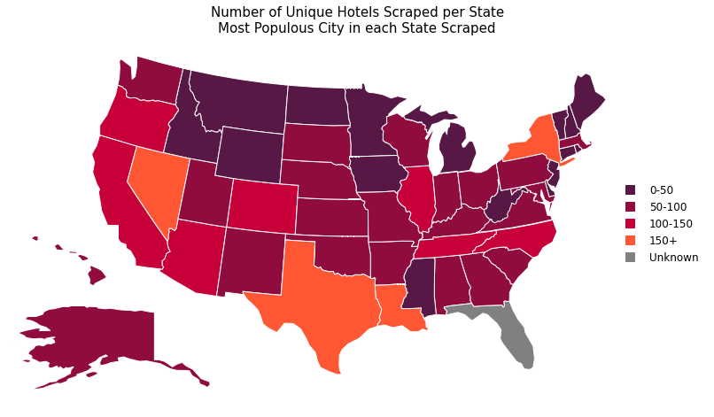
Data Visualizations – Hotels by State

Slide 12
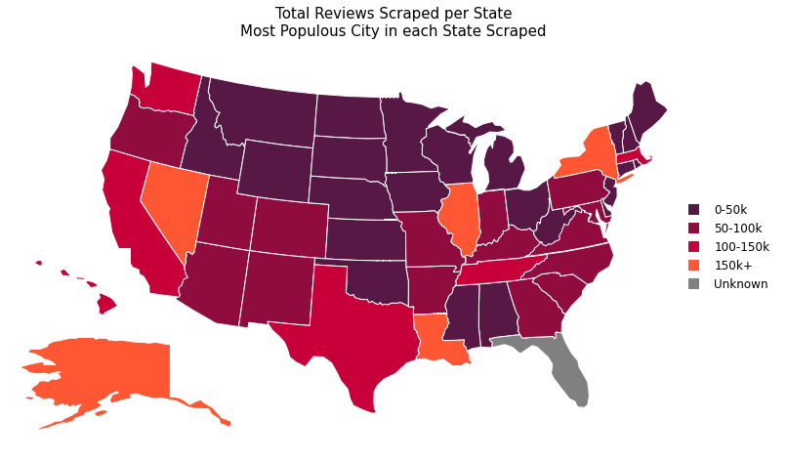
Data Visualizations – Reviews by State

Slide 13
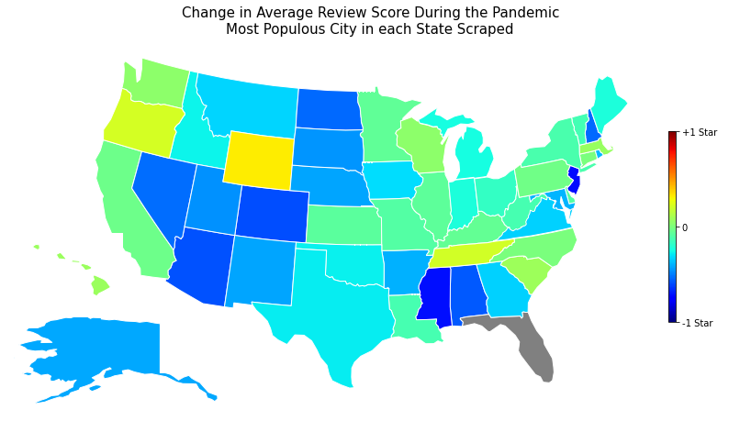
Data Visualizations – Change in Reviews

Slide 14
Feature Extraction
TfidfVectorizer
CountVectorizer
Converts the cleaned tokens into a sparse matrix of token counts
Extract unigrams and bigrams
Individual words, and the individual word +1, captures relationships.
Maximum 10000 features
Ensures that uncommon words (typos, proper names) are not represented
TfidfTransformer
Converts the sparse matrix from CountVectoriser into tf-idf
Tf-idf : Term-frequency * Inverse Document Frequency
Scales down the impact of frequent tokens

Slide 15
Feature Extraction
Ranking | All | Bad | Good | Pre-Pandemic | Post-Pandemic
0 | hotel | room | hotel | hotel | room
1 | room | hotel | room | room | hotel
2 | great | stay | great | great | great
3 | stay | night | stay | stay | stay
4 | staff | would | staff | staff | staff
5 | nice | one | nice | nice | clean
6 | location | staff | location | location | nice
7 | good | desk | clean | good | service
8 | clean | service | good | clean | location
9 | service | bed | breakfast | breakfast | time
10 | breakfast | front | friendly | service | good

Slide 16
Feature Extraction
Ranking | All | Bad | Good | Pre-Pandemic | Post-Pandemic
0 | hotel | room | hotel | hotel | room
1 | room | hotel | room | room | hotel
2 | great | stay | great | great | great
3 | stay | night | stay | stay | stay
4 | staff | would | staff | staff | staff
5 | nice | one | nice | nice | clean
6 | location | staff | location | location | nice
7 | good | desk | clean | good | service
8 | clean | service | good | clean | location
9 | service | bed | breakfast | breakfast | time
10 | breakfast | front | friendly | service | good
Clean = 28

Slide 17
Feature Extraction
Ranking | All | Bad | Good | Pre-Pandemic | Post-Pandemic
0 | hotel | room | hotel | hotel | room
1 | room | hotel | room | room | hotel
2 | great | stay | great | great | great
3 | stay | night | stay | stay | stay
4 | staff | would | staff | staff | staff
5 | nice | one | nice | nice | clean
6 | location | staff | location | location | nice
7 | good | desk | clean | good | service
8 | clean | service | good | clean | location
9 | service | bed | breakfast | breakfast | time
10 | breakfast | front | friendly | service | good
Breakfast = 22
Breakfast = 14

Slide 18

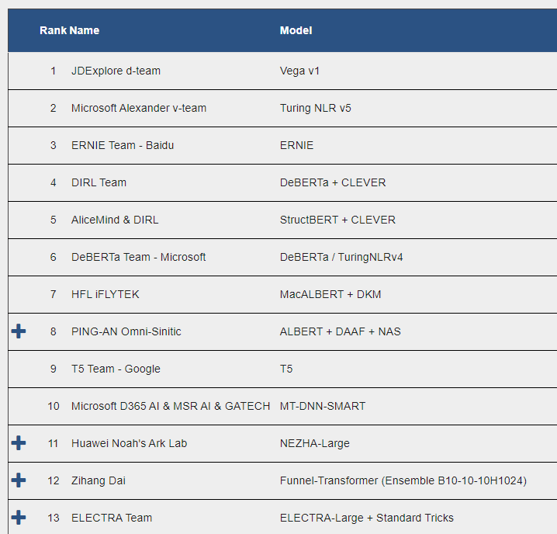
Transformer Models
ELECTRA
Very lightweight model
Uses replaced token detection, similar to a GAN network, rather than missing tokens
Performance exceeds human baselines (rank 21)
Vega
Current GLUE leader
Not available in the HuggingFace transformers library
ERNIE
3rd ranked on the leaderboard
Much larger model than Electra
Available as a transformer model
…

Slide 19
Continuing Work
Training the Transformer Model
Extracting influence measurements for features Pre and During the pandemic
Overall
By Sentiment
By State
By Region
Create a website to display findings

Slide 20
Thank you for listening.
Any Questions?

Slide 21
Supplemental Slides

Slide 22
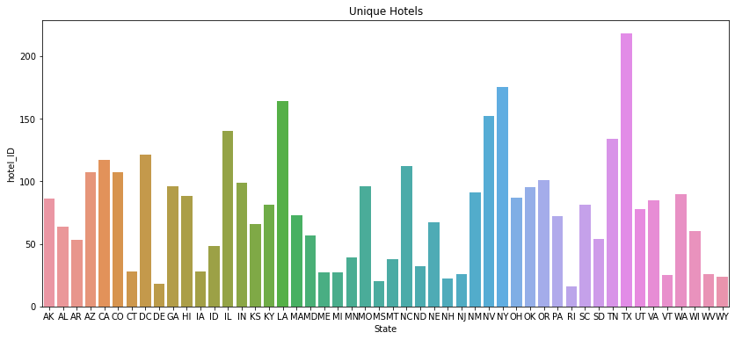
Total Unique Hotels by State

Slide 23
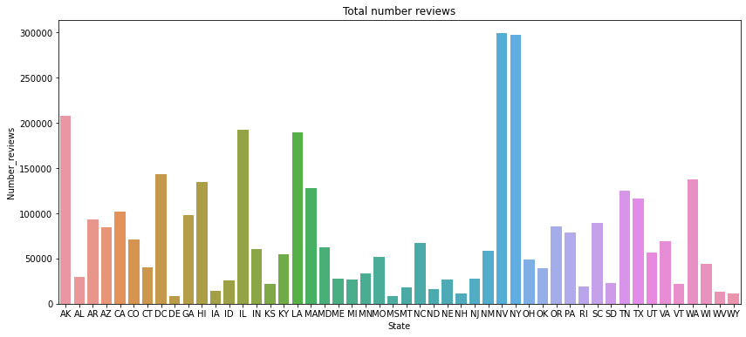
Total Unique Reviews by State

Slide 24
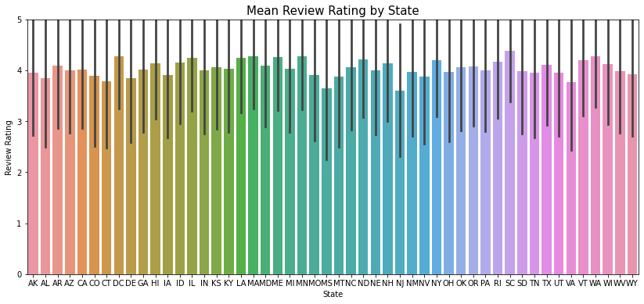
Mean Review by State with STD

Slide 25
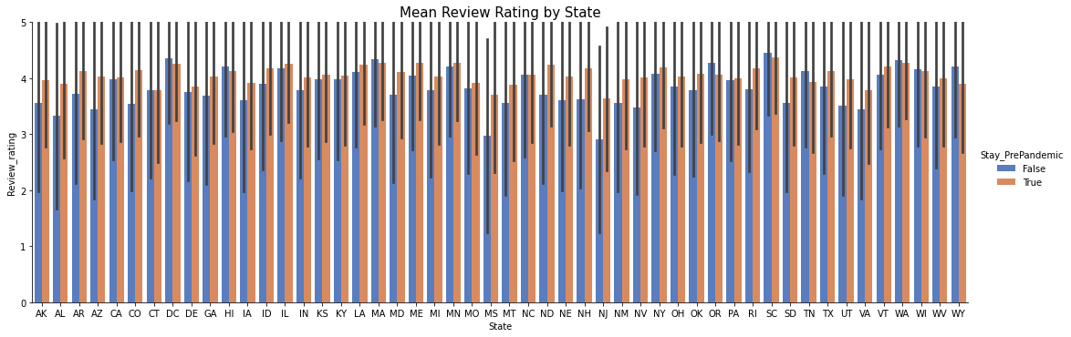
Change in Reviews by State – Pre and during Pandemic

